Slide 1


Rule Changes Affecting Extra Inning Game Length in the Pioneer Baseball League
Billy Fryer¹
¹ North Carolina State University
Abbreviated abstract: Major League Baseball has been experimenting with rule changes in order to limit game time for games that went to extra innings. This began in 2018 with the implementation of the Runner on Second Rule in the Minor Leagues. After the restructuring of MiLB in 2019, the Pioneer Baseball League rebranded as an independent league and experimented with a “Knockout Round” to replace extra innings with a homerun derby during the 2021 season. This project uses analysis of variance to quantify whether the extra inning adaptations have made an impact game time.
UCSAS
2021
billyfryer@att.net - 1

Slide 2
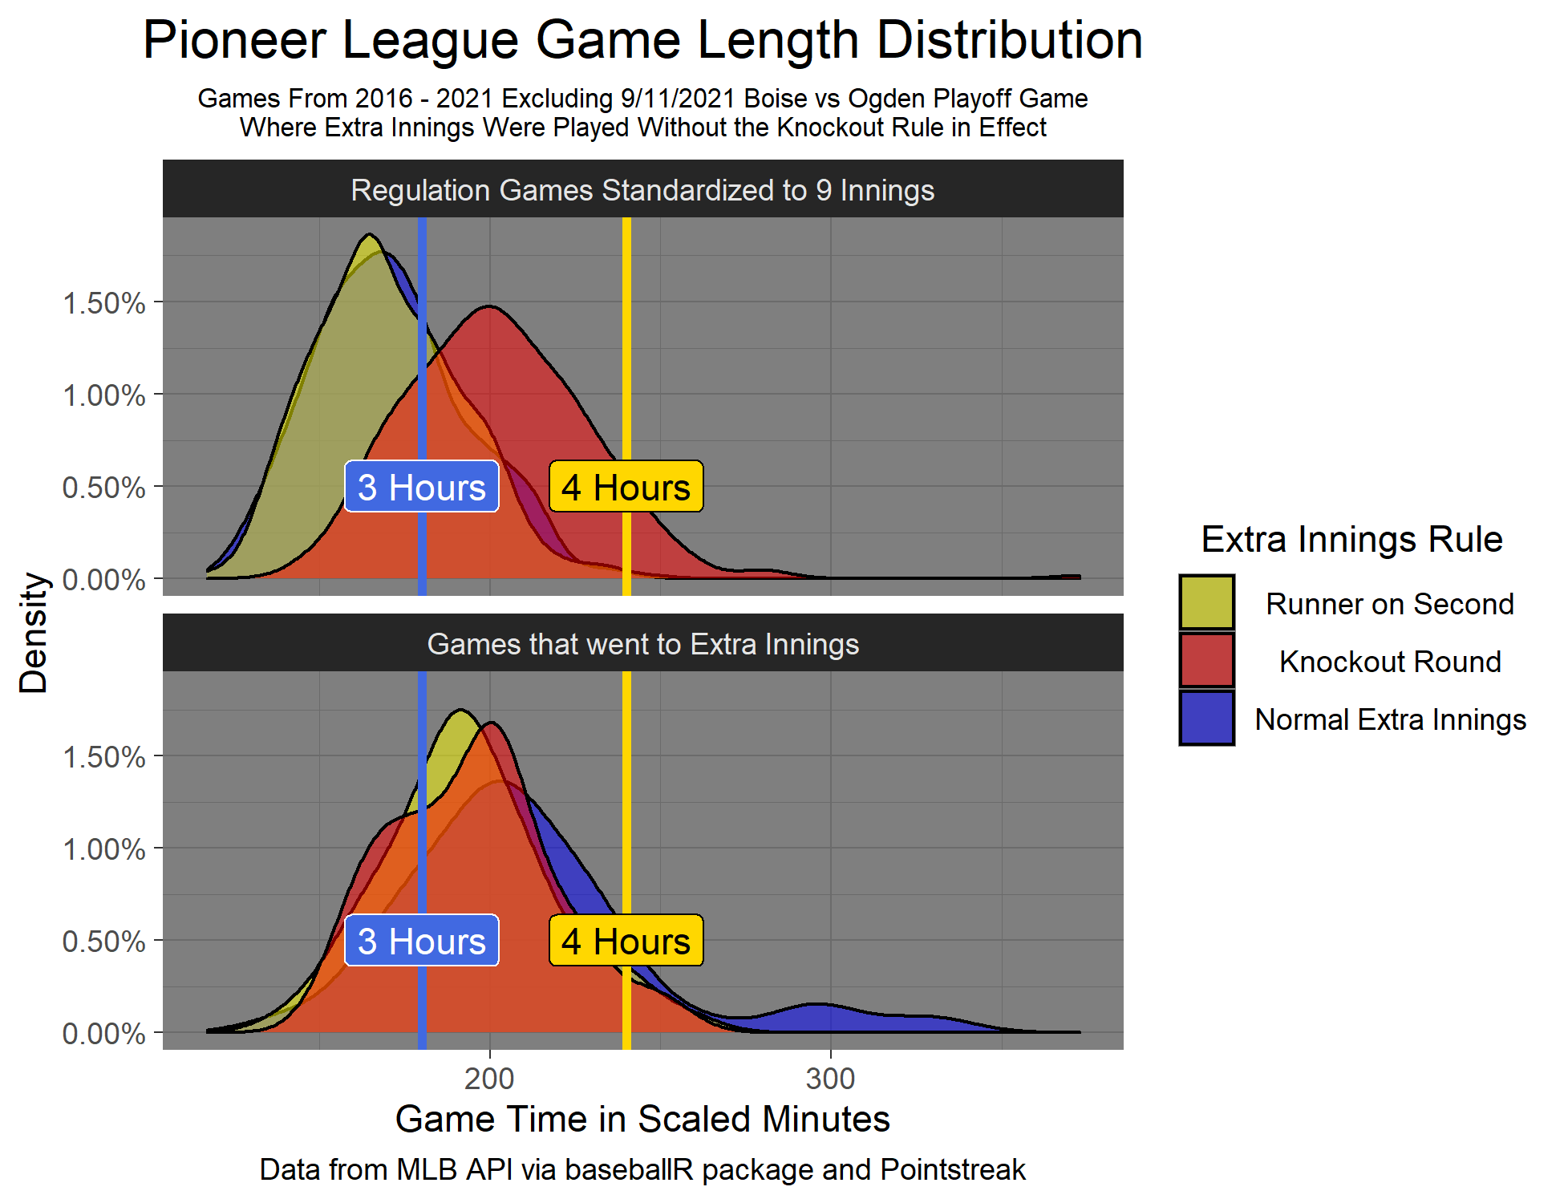
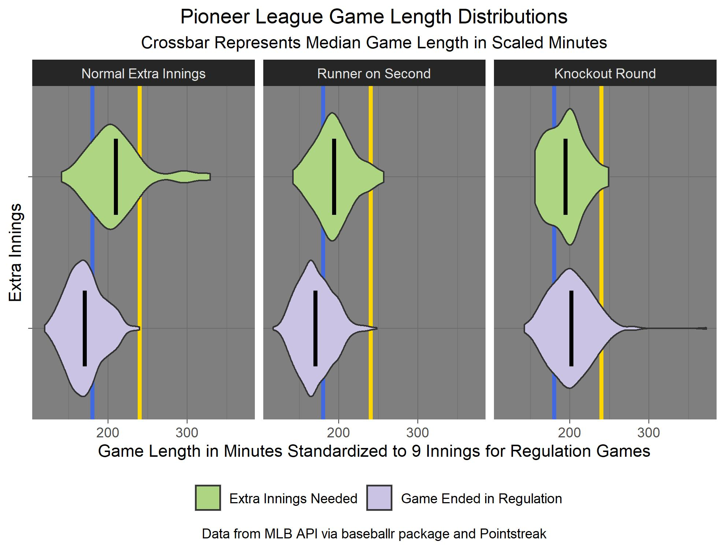
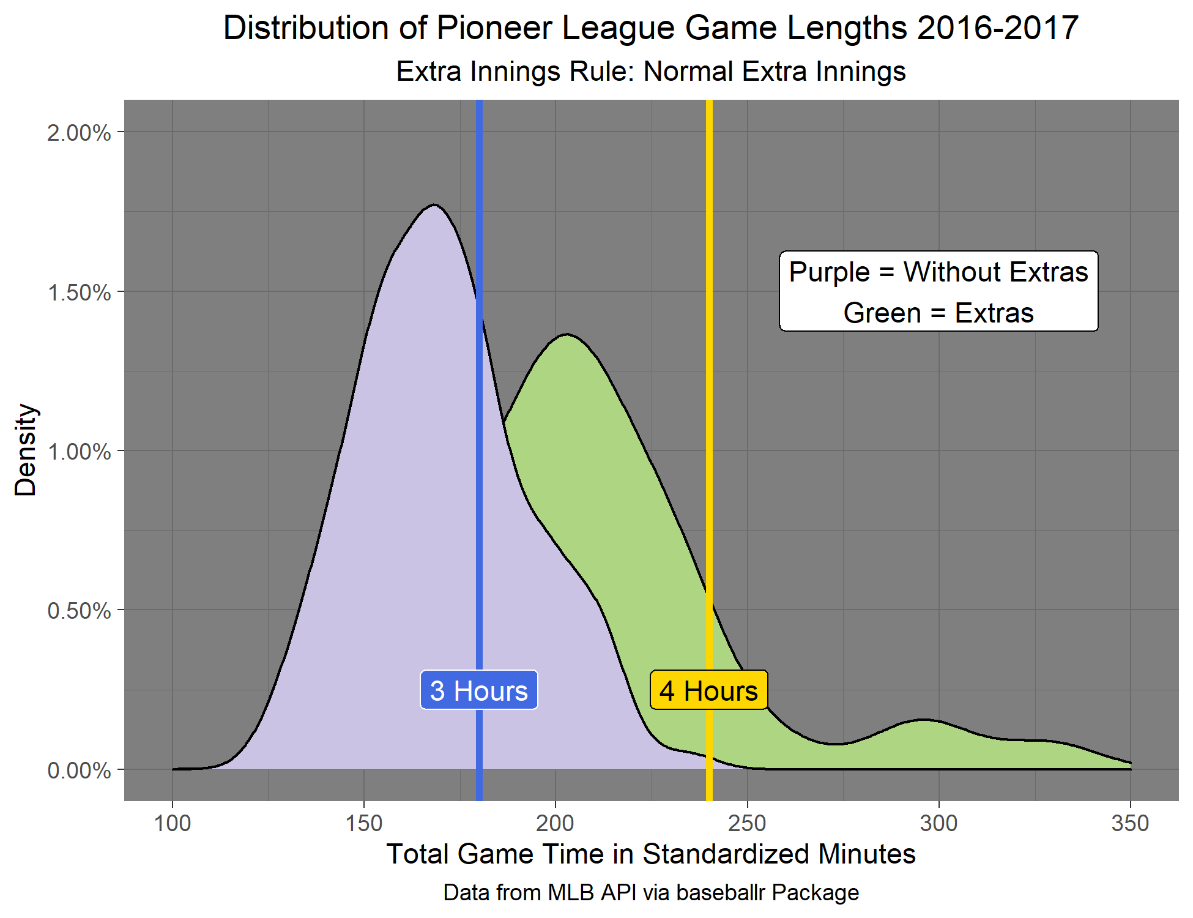
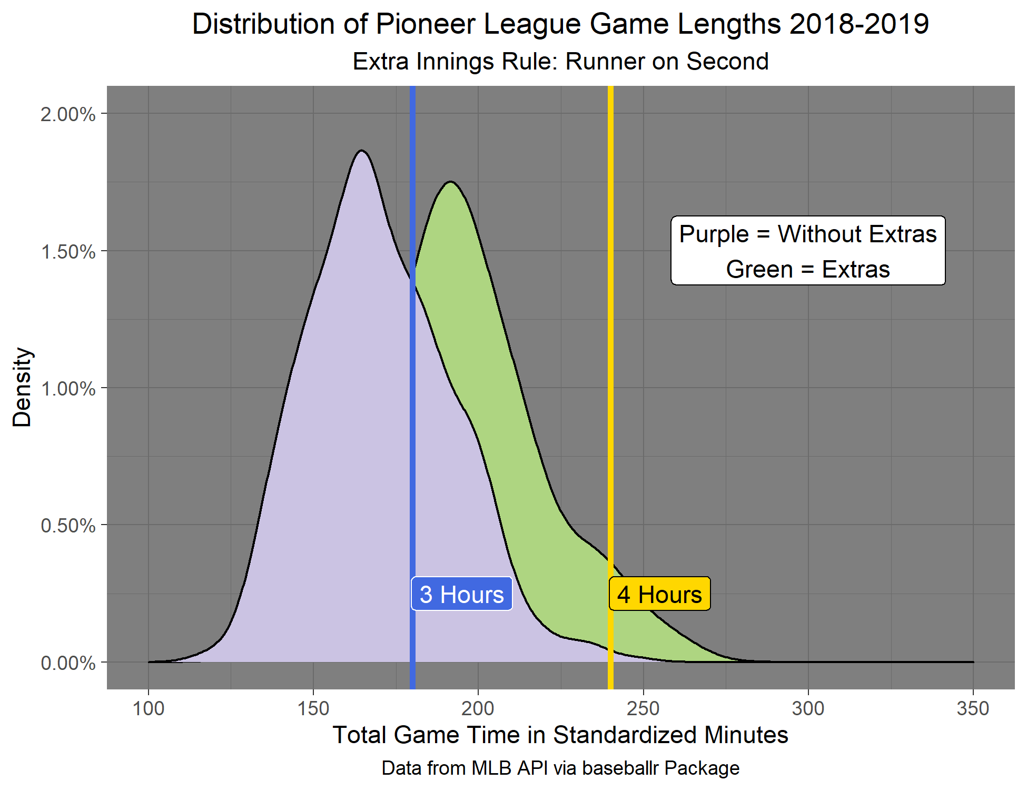
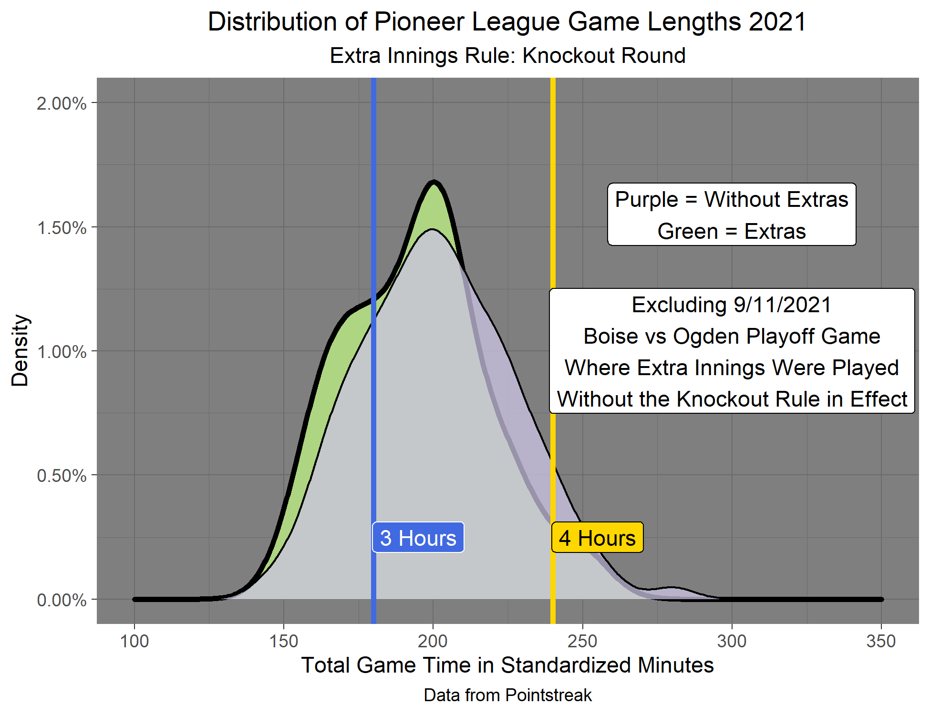
Problem: Baseball games are taking too long, especially those that are going into extra innings. This is causing a decrease in engagement, for both fans at the stadium and at home.
Solution: Three different extra inning rules have been used in the Pioneer Baseball League over the past 5 seasons: Normal Extra Innings, Extra Innings starting with a Runner on Second, and the Knockout Round which utilizes a 5-swing homerun derby to determine the winner.
Data is from MLB API for 2016-19 Seasons.
Data is from Pointstreak for 2021 Season.
UCSAS
2021
billyfryer@att.net - 2

Slide 3
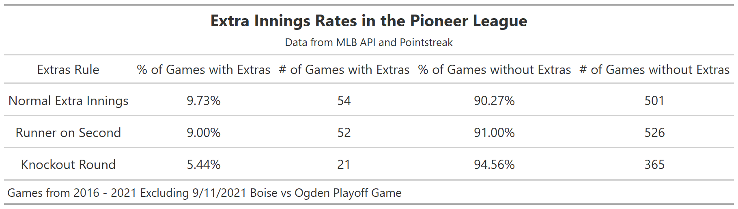
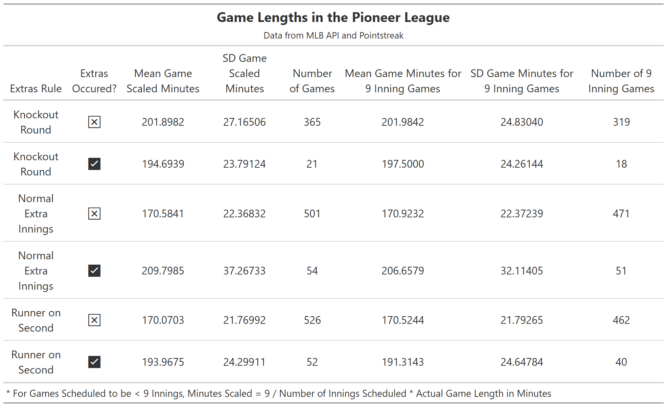
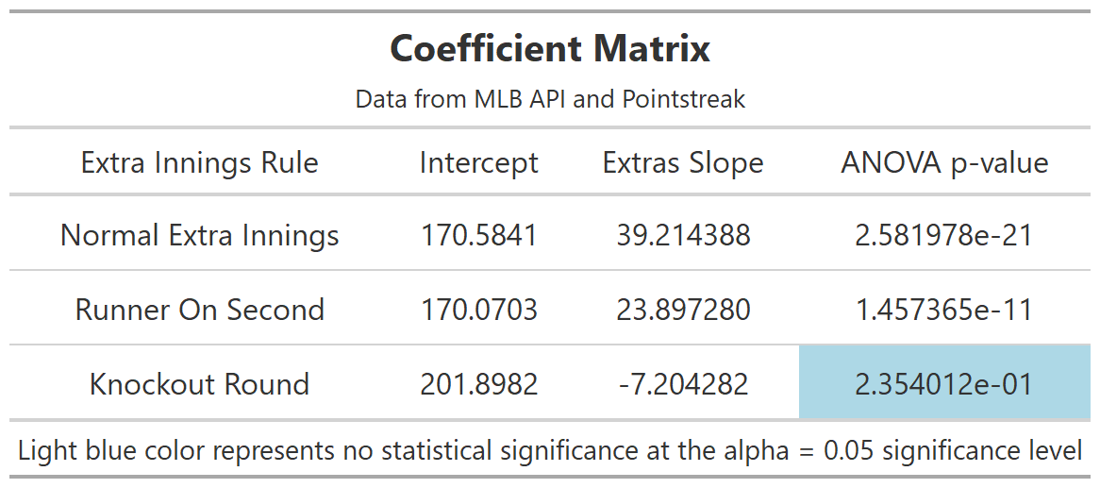
Methodology and Drawbacks
First order linear regressions models were fit followed by performing the Analysis of Variance (ANOVA) procedure to find if there was a statistical significance difference in game time for games that went to extra innings in contrast to those that did not. For the Normal Extra Innings and Runner On Second Rules, statistically significant differences were found at the α = 0.05 significance level. For the Knockout Round the hypothesis that extra innings changed the game length could not be rejected.
There were 2 major drawbacks to this study. For the Knockout Round games where the rule did come into effect, the sample size is only n = 21, which is not large enough to draw definitive conclusions. This analysis also follows the assumption that the level of play was consistent between all seasons in the study. This is not the case for the 2021 season after the league became independent from MLB. This change in skill level gave hitters a large advantage and allowed more hits and runs increasing game length. Consequently, the mean game length when the Knockout Round or extra innings were not needed was longer in 2021 compared to previous seasons.
UCSAS
2021
billyfryer@att.net - 3

Slide 4








Conclusions and Additional Information
On average, the Knockout Round appears to be the most efficient in reducing the length of games, however due to the small sample size (n = 21) there is not strong enough evidence to make a firm conclusion. More games with the Knockout Round need to be played during the 2022 Season. The Runner on Second Rule does appear to end games that go to extra innings quicker than playing Normal Extra Innings, meaning that the Runner on Second Rule fulfills its purpose. This finding is consistent with Major League Baseball’s decision to implement the Runner on Second Rule in MLB games during the 2020 and 2021 seasons.
This study is completely reproducible. The full paper and all code is available at https://github.com/b4billy/Pioneer-Project.
UCSAS
2021
billyfryer@att.net - 4

